Slide 1
Transfer Exam Workshop
2017

Slide 2
Transfer Exam guidelines
When do I take the exam?
Can I take the exam? - requirements
Format of the exam
Evaluation of the exam
What happens if I pass?
What happens if I do not pass?
http://med.uottawa.ca/graduate-postdoctoral/students/transfer-phd

Slide 3
Fast tracking to the PhD
Fast tracking to the PhD program is reserved for only the most outstanding candidates and is considered a privilege
Transfer must occur by the end of the 5th term of M.Sc. studies (all requirements must be complete except thesis)
The transfer exam = Comprehensive exam (if you pass, you will not have to do the Comp as a PhD student)
High standards to pass
TAC + 1 examiner (often will become the 3rd TAC member)
Other requirements: http://med.uottawa.ca/graduate-postdoctoral/students/transfer-phd

Slide 4
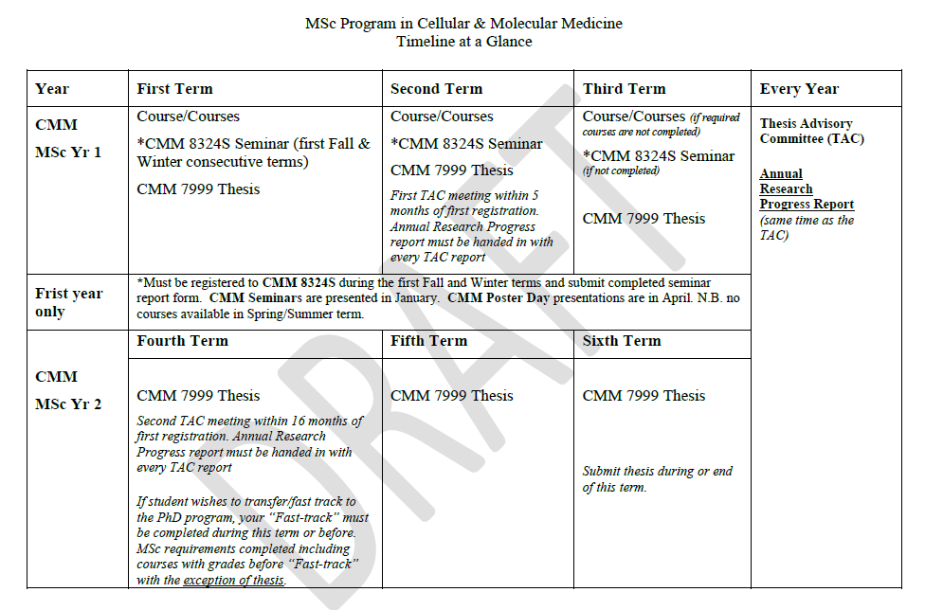
Program Milestones - MSc
MED8166
TAC + annual report

Slide 5
Requirements
Completion of all the program requirements
Support from your thesis director
Support from the Program Director (this happens after the exam)

Slide 6
Program Requirements
MSc Program
6 credits of courses, of which 3 credits must be from CMM = 2 courses
Seminar course (CMM8324S)
Thesis
MED8166 – Professionalism and Professional Skills
PhD Program
6 credits of courses, of which a minimum of 3 credits from CMM
Seminar course (CMM8325S)
MED8166 – Professionalism and Professional Skills
Comprehensive exam
Thesis (includes PhD Research Seminar)
All program requirements must be completed to transfer to the PhD

Slide 7
Format of the Exam
This is the Comprehensive Exam with all of the same requirements with one important difference – YOU ONLY HAVE ONE CHANCE TO PASS
Two part exam that takes several weeks to complete
Written research proposal
Oral exam (defense of the research proposal)

Slide 8
Declare your intention
Your supervisor selects your examination committee (your two TAC members + one researcher outside of your committee)
There is a form for this and it must be approved by the Program Director
Inform the Grad Office by email of our intent to take the exam (6 weeks prior) along with expected dates for submission of the research proposal
This is necessary to begin the scheduling of the oral defense.
Cc your supervisor so that their support is implicit

Slide 9
Research Proposal
Formal document prepared by you that builds on your research progress in the MSc program and proposes your experimental plan for the completion of the PhD
You must, therefore, decide your topic in a very narrow scope and ensure that all of your experimental aims are sufficiently independent enough to allow you to make a significant contribution to scientific knowledge in your field by the end of your studies, a requirement for the completion of a doctoral degree.

Slide 10
Research Proposal Format
Title page
Abstract (350 words)
Introduction
Lit review
Your results to date
Build your case
Rationale and Hypothesis
Experimental Aims and Methods
2-3 aims
Consider limitations to the methods used
Significance
References
15 pages maximum including figures
THERE ARE FORMAT GUIDELINES

Slide 11
Verdict on the Research Proposal
Verdict 1: The research proposal is ready to proceed to oral examination, the candidate will be asked to prepare for oral examination.
Verdict 2: The candidate will be asked to complete an MSc degree. A second examination is not permitted.
Verdict is determined by majority.

Slide 12
Oral exam
Like a thesis defense
There is a formal evaluation sheet for the oral exam with specific criteria (more on this)
NS/S verdict, voted as a majority

Slide 13
Evaluation Criteria
*To pass the oral defense of the Comprehensive Exam, each learning objective must receive a minimum evaluation of “good”.
Degree level expectation | Learning outcome to evaluate | Poor | Fair | Good | Very good | Excellent
Depth and breadth of knowledge | Demonstrates sufficient basic knowledge in the fields of cellular and molecular biology (as appropriate for the project)
 | Demonstrates knowledge of the literature in the field of study
Research and scholarship | Can define research questions based on a sound rationale
 | Demonstrates ability to critically evaluate scientific literature
 | Can develop a research plan to address the research hypothesis
Level of application of knowledge | Has demonstrated the ability to undertake scientific research and generate data
 | Demonstrates the ability to interpret results of a scientific experiment
 | Is aware of the appropriate experimental techniques used in their field of research
Professional capacity/ autonomy | Recognizes the societal benefit of their proposed research
Level of communica-tion skills | Can communicate scientific content, results and hypotheses clearly and efficiently using appropriate terminology
Awareness of limits of knowledge | Can discuss the strengths and limitations of the experimental plan

Slide 14
And if I pass?
The Program Director approves everything and you are registered as a PhD student for the next semester.
You must complete all of the requirements for the PhD (nothing is carried forward)

Slide 15
And if I fail…
You must complete the MSc degree, i.e. write your thesis and defend it
This does not impact your ability to apply for the PhD program (with your supervisor or in another lab)
Please note: Failures DO happen, more often than you are likely aware
Reasons:
Not taking the exam seriously enough
Not actually ready for the Comprehensive exam, but still an excellent student (remember the comp is usually done in the second year of the PhD program)
Failures do not mean you cannot be highly successful as a PhD candidate

