Slide 1
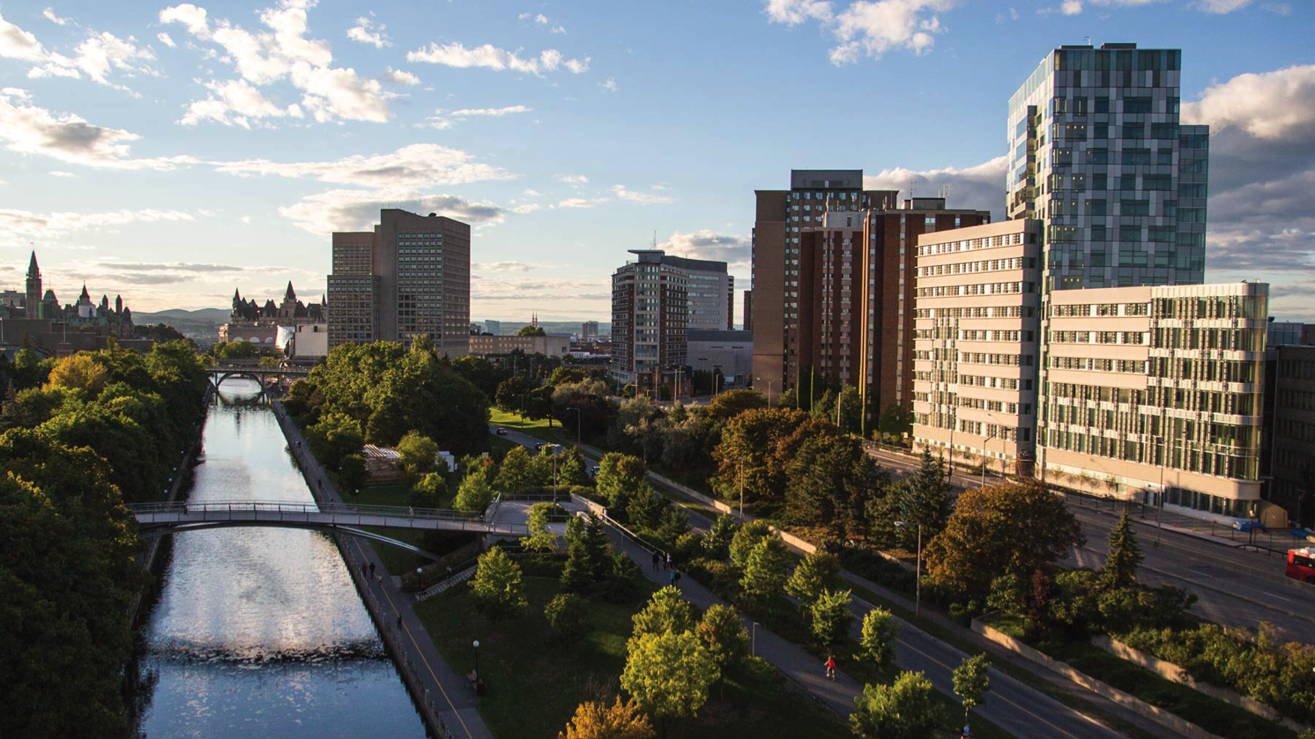
Comprehensive Ph.D. exam
Presented by par : Jean-Claude Béïque
med.uOttawa.ca

Slide 2
What is a comprehensive exam?
The comprehensive exam is a two-part exam used to evaluate the depth and breadth of knowledge as well as research skills early in the doctoral program.
The exam consists of both a written component (a research proposal) and an oral examination.
If a PhD student fails one of the components of the comprehensive exam, the student may ask for one re-examination.
Failure to pass the re-examination will result in a withdrawal from the PhD program.

Slide 3
Objectives:
The comprehensive exam will evaluate whether a candidate has the research knowledge and skills required to successfully complete a doctoral program, such as:
General and project-specific scientific knowledge
Knowledge of the scientific literature in the proposed field of study
Ability to generate a research question and to propose an experimental plan
Ability to use research methodologies and to interpret results (generated during the first year of studies)
Ability to communicate science both written and orally
Ability to put the proposed work in the context of the broader field of research
Potential to identify limitations of their chosen approaches and make informed judgments in their specific field of research

Slide 4
Objectives:
develop scientific writing skills;
develop critical thinking skills;
develop scientific creativity;
expand knowledge in the field of research.

Slide 5
Timeline
The Comprehensive exam should be completed coincident with the second TAC meeting, normally in the 4th term after first enrolment.
The comprehensive exam should occur within the 4th or 5th term of first enrolment.
In the event of re-examination, the exam must be successfully completed before the end of the 6th term.
MD/PhD students :
The Comprehensive Examination must be successfully completed by the end of Year 3 (term 5).
Students who entered the MD/PhD Program without a Master’s degree have until the first term in Year 4 to complete the Comprehensive Exam.

Slide 6
Scheduling:
At least six weeks prior the anticipated date of the comprehensive exam, you need to inform the Graduate and Postdoctoral Office (GPSO) by email of the date chosen by the supervisor and the evaluation committee for the examination, or of your preferred date if your supervisor and committee members haven’t yet agreed on a specific date.
To your email you must add your supervisor in cc and co-supervisor if applicable and attach the following documents:
Research abstract
The Comprehensive Examiner Nomination Form (PDF) - names of potential examiners chosen by the supervisor.
The Program Director will approve the nomination of the committee members.

Slide 7
Scheduling:
As soon as the GSPO has the approval of the director we will assist with the scheduling of the event by confirming the time and location of the exam.
At least 3 weeks prior to the exam, you must circulate your research proposal by email to the examination committee with the GSPO in cc.

Slide 8
Examination Committee:
2 TAC members, and
one additional examiner who will be nominated as the chair for the exam.
At least one of the committee members should be from the home graduate program.
Following submission of the written component, the members of the examination committee will be granted one week to complete its evaluation.
All examiners and supervisors are required to be present during the oral examination.

Slide 9
Role of the supervisor and the student:
The proposal is to be written by the student as an independent exercise.
The supervisor will not edit the proposal, but should provide feedbacks on the scope of the research and the hypotheses.
The supervisor may also be consulted on matters of methodology or format of the proposal.

Slide 10
The Research Proposal
The title page should include the title of your proposal, your name and student number, your supervisor’s name, the date you began the PhD program, the date of submission of the research proposal and the following statement: Submitted in partial fulfillment of the requirements for the Comprehensive Exam.

Slide 11
The Research Proposal
ABSTRACT:
A 350 word summary of the proposed research proposal. This abstract should include:
a statement of the problem
a rationale for the proposed research
the hypothesis and experimental aims
a brief description of the experimental plan
a statement about the significance and/or implications of the proposed work

Slide 12
The Research Proposal
Introduction
Rationale and Hypothesis
Experimental Aims and Methods
Significance
References
https://med.uottawa.ca/graduate-postdoctoral/students-hub/students-comprehensive-examination

Slide 13
General Format
The Research proposal should not exceed 15 type-written pages including figures but excluding references. Margins must be set to a minimum of 1 inch (2.54 cm).
The document should be prepared using Times New Roman 12 pt. The document should be prepared single spaced.
Figures should be inserted into the text with tight text wrapping using Arial 10 pt as a minimum font size in the final version.
Each figure should include a concise legend that describes the experiment performed similar to what is appropriate for scientific publication.
Figure that exceed one half-page width but do not extend to the full page width reduce readability. You will have to be very selective with the figures you include to manage your space efficiently.
https://med.uottawa.ca/graduate-postdoctoral/students-hub/students-comprehensive-examination

Slide 14
Assessment and Evaluation
The comprehensive examination is evaluated as (S) Satisfactory or (NS) Not Satisfactory.
Each component (written and oral) is evaluated by the examination committee including the Chairperson.
The student can fail either the written (research proposal) or the oral component.

Slide 15
Assessment and Evaluation
Following submission of the written component, the examination committee will be granted 1 week to complete its evaluation with two possible verdict outcomes:
Satisfactory: the research proposal is ready to proceed to oral examination, the candidate will be asked to prepare for oral examination.
Not Satisfactory: the research proposal must be revised if more than one examiner requires major changes.
A minimum of 2 satisfactory votes are required to successfully pass the written component of the Comprehensive Exam.

Slide 16
Oral Exam:
For the oral exam, the PhD candidate will be asked to present a short 15 minute summary of their research topic and their proposal, followed by two rounds of questioning in which the student’s basic scientific and technical knowledge will be evaluated.
The Chairperson will ensure the efficient conduct of the exam and a respectful examination environment.
The thesis supervisor may not ask or answer questions during the exam.
A minimum of 2 satisfactory votes are required to successfully pass the oral exam. A student whose performance is deemed to be not satisfactory (more than one not satisfactory vote) will either be asked to repeat the exam or will be withdrawn from their program (if it is a second fail).
https://med.uottawa.ca/graduate-postdoctoral/students-hub/students-comprehensive-examination

Slide 17
Overall tips:
WRITING:
Plan ahead. Scientific writing is challenging. It’s unlike anything you’ve written before.
Think of your reader. Think of your reader. Think of your reader. Have a conversation.
Make up a general plan before you start. Fill in the gaps after.
Beyond the general guidelines, there are no pre-determined writing format. This does not mean that there are no preferred formats.
Hourglass shape structure. One paragraph, one idea. Strong lead sentence, strong closing wrap-up sentence.
Scope of the experimental plan: admittedly ambiguous and somewhat subjective. Reviewers have different expectations. A way around it is to be specific: e.g., Student #1 will carry out section X, Student #2 will carry Y, and a postdoctoral fellow will carry out section Z. This shows that you have been thinking broadly about your project, have more ideas than your immediate contribution, and have a realistic understanding of experimental progress/expectations.
Rule of thumb: reviewers will have a CIHR grant as their reference. Think 5 years, 3 trainees.

Slide 18
Overall tips:
Common mistakes:
Overly ambitious.
Mismatch between the overall pitch and the actual experimental plan (e.g., “Consciousness is an ill-understood metaphysical and spiritual concept that lies at the heart of the human experience. Here, we will study the biophysical interactions between proteins x and y”). Don’t give false expectations to your reader.
An experimental plan is not a laundry list. Favor clarity over exhaustiveness.
What experiments will be carried out and how will they be carried out is (obviously) important. Don’t forget the why. Why is this important? Why should we care?
Assume too much knowledge from your reader. You think professors know everything. They don’t. Rule of thumb when giving a talk or writing a grant: Assume infinite intelligence, but zero knowledge from your reader.

Slide 19
Overall tips:
Oral Exam:
Relax.
The expectations of the knowledge you should have is reasonable. In other words, you are not expected to know everything (this is self-evident, but worth remembering).
The corollary of this point is that you should readily acknowledge your ignorance on a particular point, rather than try to invent an answer. Your attitude towards Science matters.
Be candid. “This is a good question, but I’m really not sure about the answer. My intuition is however that …” is often an acceptable answer.
If you know the answer, go for the kill. Don’t meander.
Know your audience. You can/should try to guess what your specific examiners are likely to view as minimal obligatory knowledge. You will likely miss, but it’s not a bad exercise.
Reviewers are often truly interested in your topic and take your comprehensive exam as an opportunity to increase their own knowledge: Their questions may be genuine, and they may not know the answers. And this is OK. Try to engage in a scientific conversation with them. Be curious and interested in what they have to say.
Don’t forget: your success is everyone's success. Your reviewers want you to nail it.
Relax.

